Slide 1
SEARCHING TECHNIQUES WINNING CAMP 2023

Slide 2
Searching
Searching Algorithms are designed to check for an element or retrieve an element from any data structure where it is stored. Based on the type of search operation, these algorithms are generally classified into two categories:
Sequential Search: In this, the list or array is traversed sequentially and every element is checked. For example: Linear Search.
Interval Search: These algorithms are specifically designed for searching in sorted data-structures. These type of searching algorithms are much more efficient than Linear Search as they repeatedly target the center of the search structure and divide the search space in half. For Example: Binary Search.

Slide 3
Searching Methods
A search algorithm is the step-by-step procedure used to locate specific data among a collection of data.
Different algorithms used for searching are
Linear Search
Binary Search
Jump Search
Fibonacci Search
Interpolation Search
Exponential Search
3

Slide 4
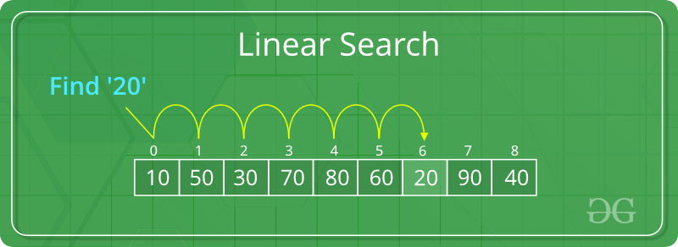
Search Element using Linear Search
A simple approach is to do linear search, i.e
Start from the leftmost element of arr[] and one by one compare x with each element of arr[]
If x matches with an element, return the index.
If x doesn’t match with any of elements, return -1.

Slide 5
Linear Search
LINEAR(DATA, N, ITEM, LOC)
Here DATA is a linear array with N elements, and ITEM is a given item of information. This algorithm finds the location LOC of ITEM in DATA, or sets LOC = 0 if the search is unsuccessful.
[Insert ITEM at the end of DATA] Set DATA[N+1] = ITEM
[Initialize counter] Set LOC = 1
[Search for ITEM]
Repeat while DATA[LOC] ≠ ITEM
Set LOC = LOC + 1
[End of loop]
[Successful?] If LOC = N+1, then: Set Loc = 0
Exit

Slide 6
Algorithm
Linear Search ( Array A, Value x)
Step 1: Set i to 1
Step 2: if i > n then go to step 7
Step 3: if A[i] = x then go to step 6
Step 4: Set i to i + 1
Step 5: Go to Step 2
Step 6: Print Element x Found at index i and go to step 8
Step 7: Print element not found
Step 8: Exit

Slide 7
Pseudocode
procedure linear_search (list, value)
for each item in the list
if match item == value
return the item's location
end if
end for
end procedure

Slide 8
Binary Search
Search a sorted array by repeatedly dividing the search interval in half.
Begin with an interval covering the whole array.
If the value of the search key is less than the item in the middle of the interval, narrow the interval to the lower half.
Otherwise narrow it to the upper half. Repeatedly check until the value is found or the interval is empty.

Slide 9
Binary Search Algorithm
Binary search algorithm is efficient if the array is sorted.
A binary search is used whenever the list starts to become large.
Consider to use binary searches whenever the list contains more than 16 elements.
The binary search starts by testing the data in the element at the middle of the array to determine if the target is in the first or second half of the list.
If it is in the first half, we do not need to check the second half. If it is in the second half, we do not need to test the first half. In other words we eliminate half the list from further consideration. We repeat this process until we find the target or determine that it is not in the list.

Slide 10
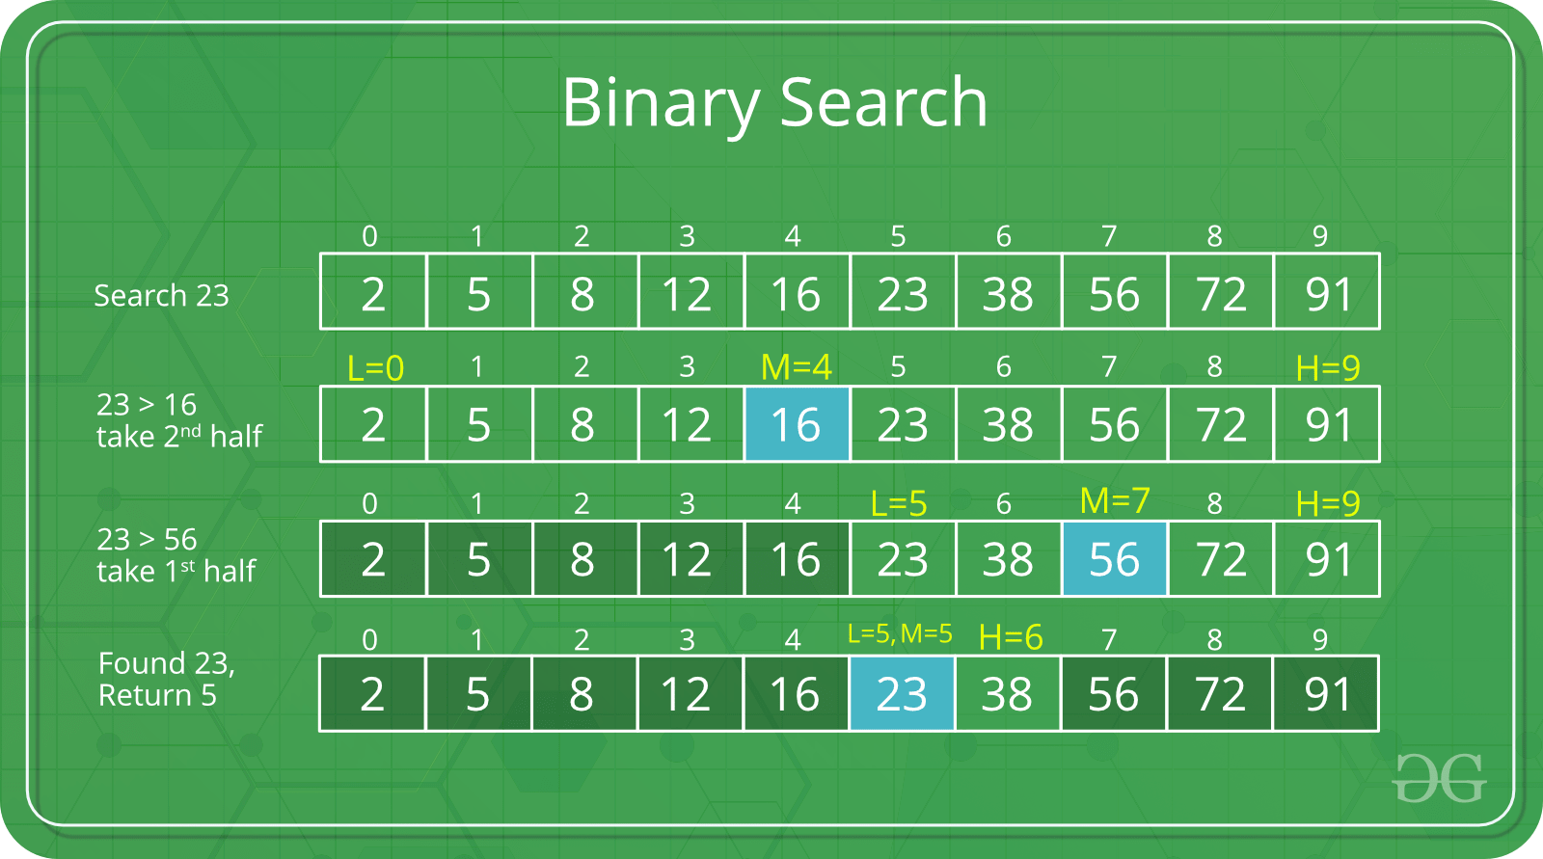
Example

Slide 11
Binary Search Algorithm
1. [Define variables]
ST = LB, LAST= UB;
MID = (ST+LAST)/2;
Repeat 3 and 4 DO ST <= LAST & DATA[MID] != ITEM
3. If ITEM < DATA[MID] then
LAST = MID-1
If not
ST = MID+1
4. Set MID = INT((ST + LAST)/2)
[LAST repeat to 2]
5. If DATA[MID] = ITEM then
LOK = MID
If not,
LOK = NULL
6. Stop

Slide 12
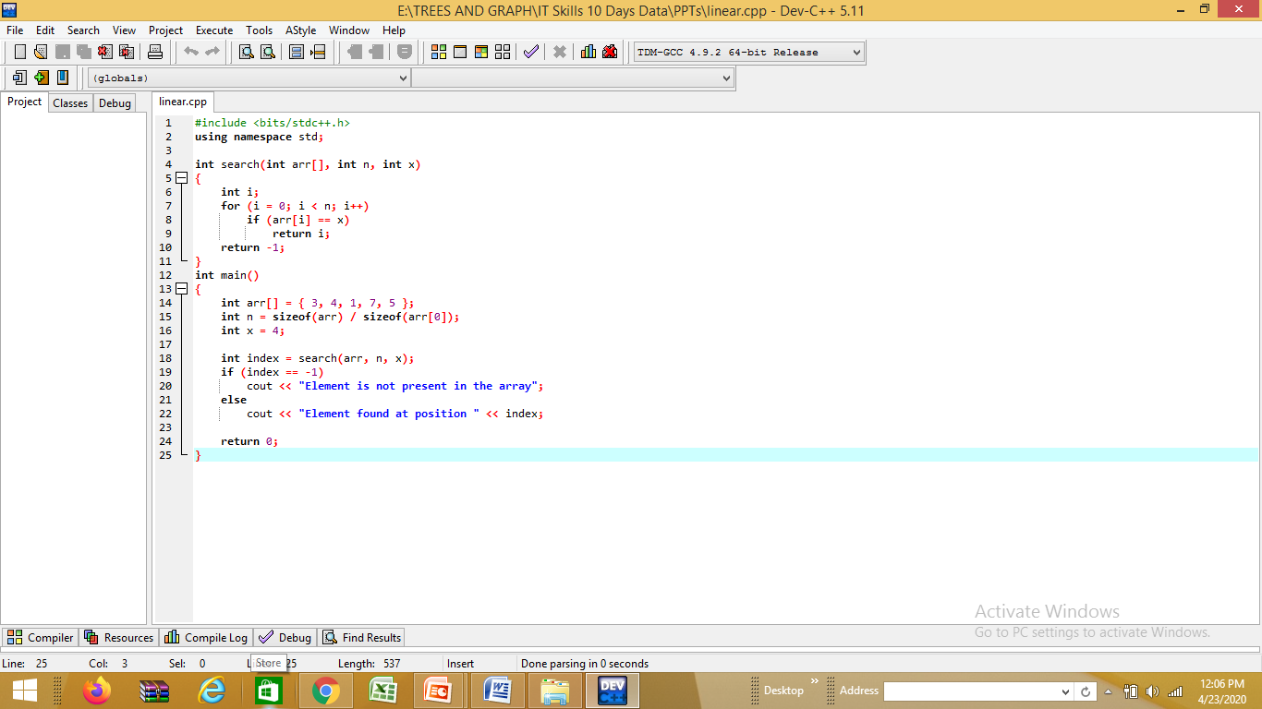
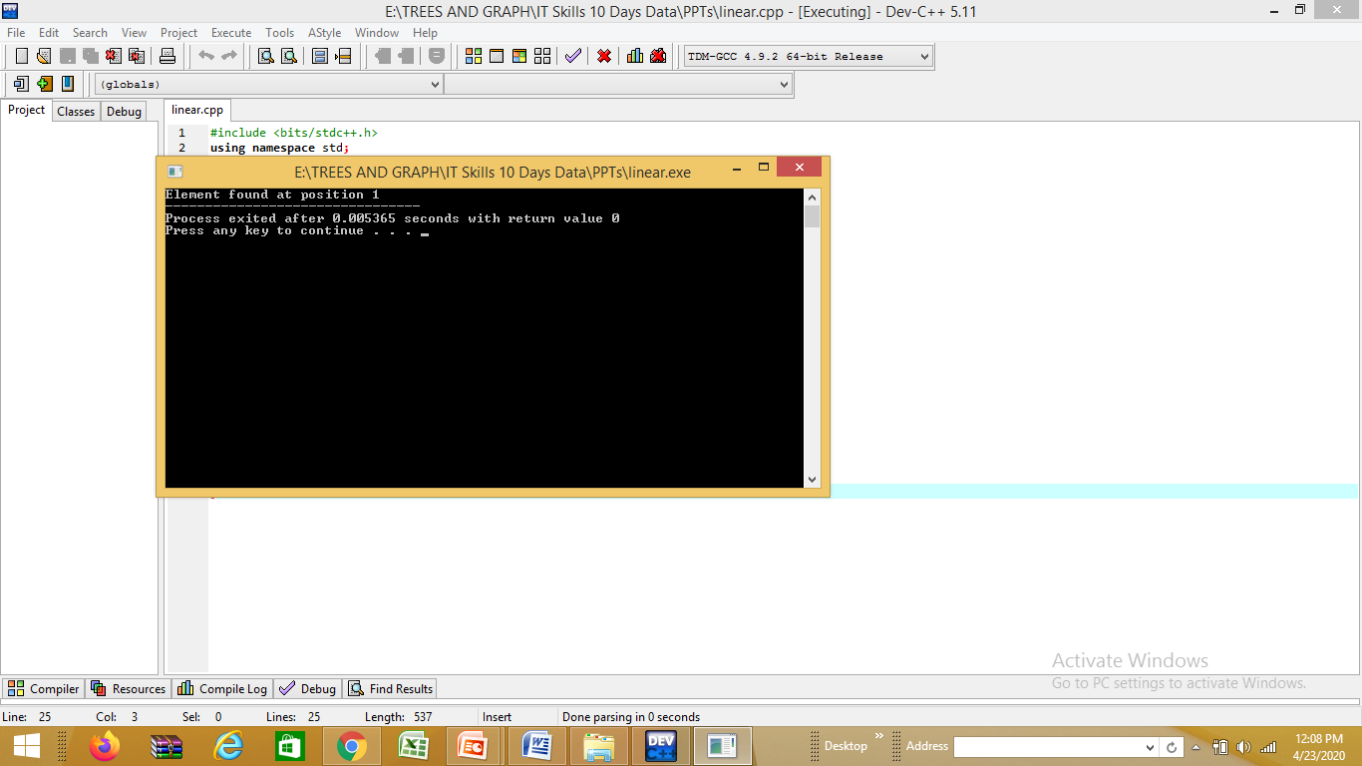
Linear Search
Solve the Problem

Slide 13
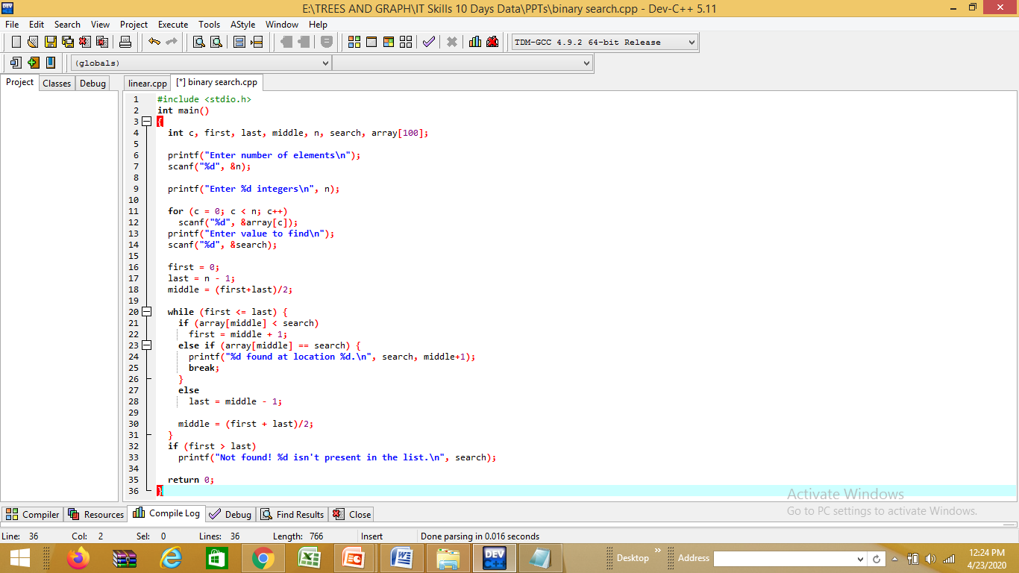
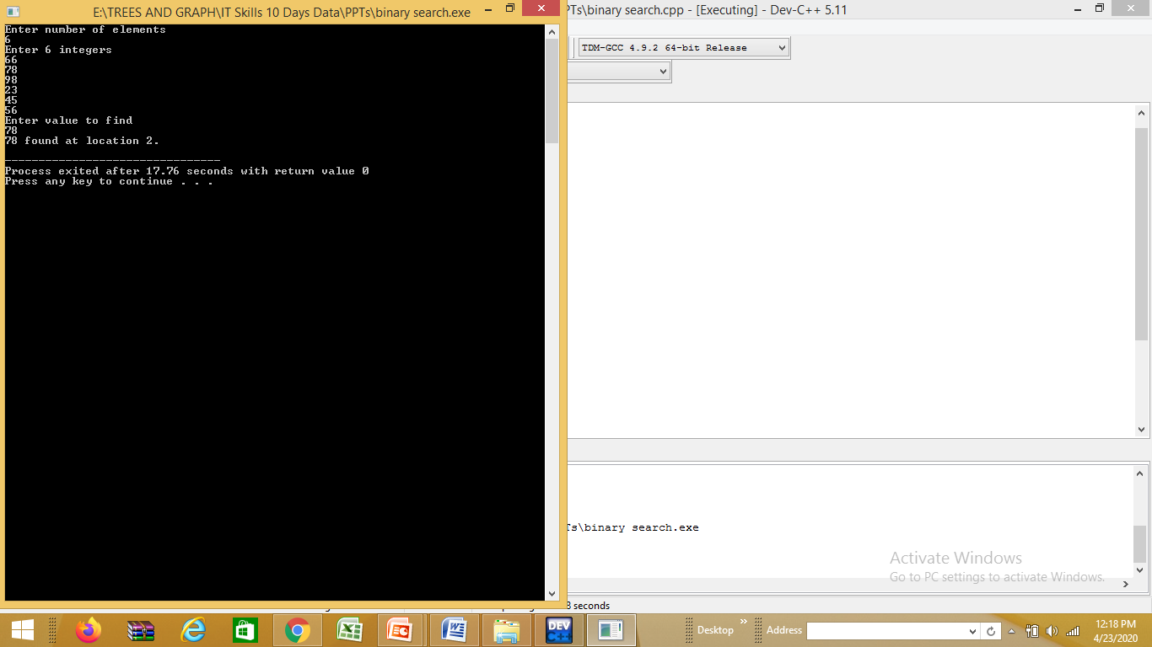
Binary Search
Solve the problem

Slide 14
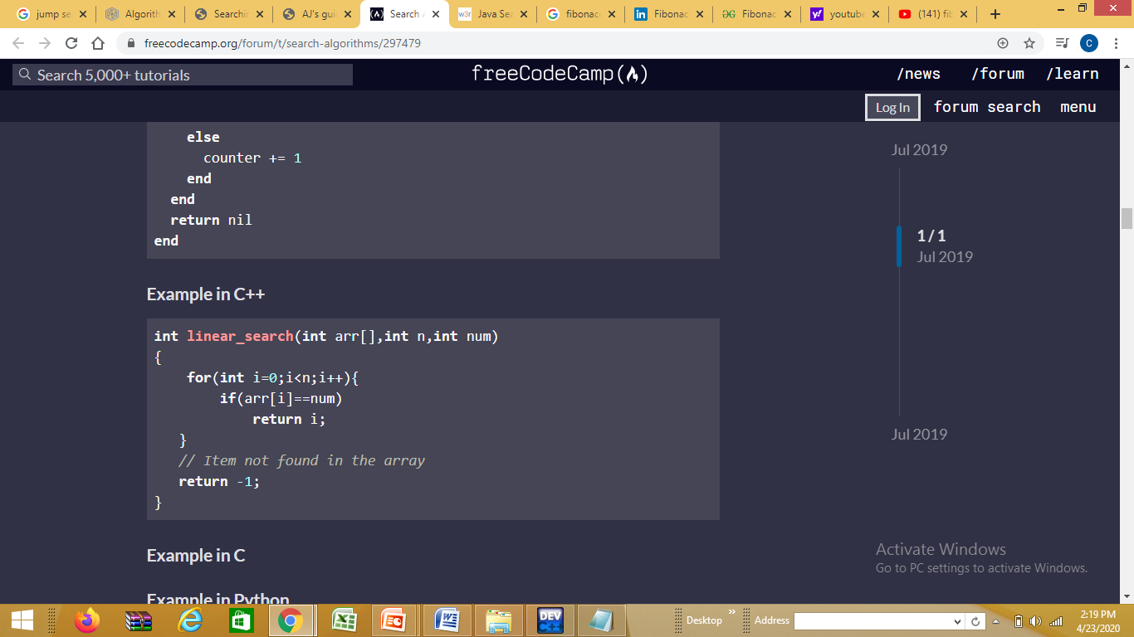
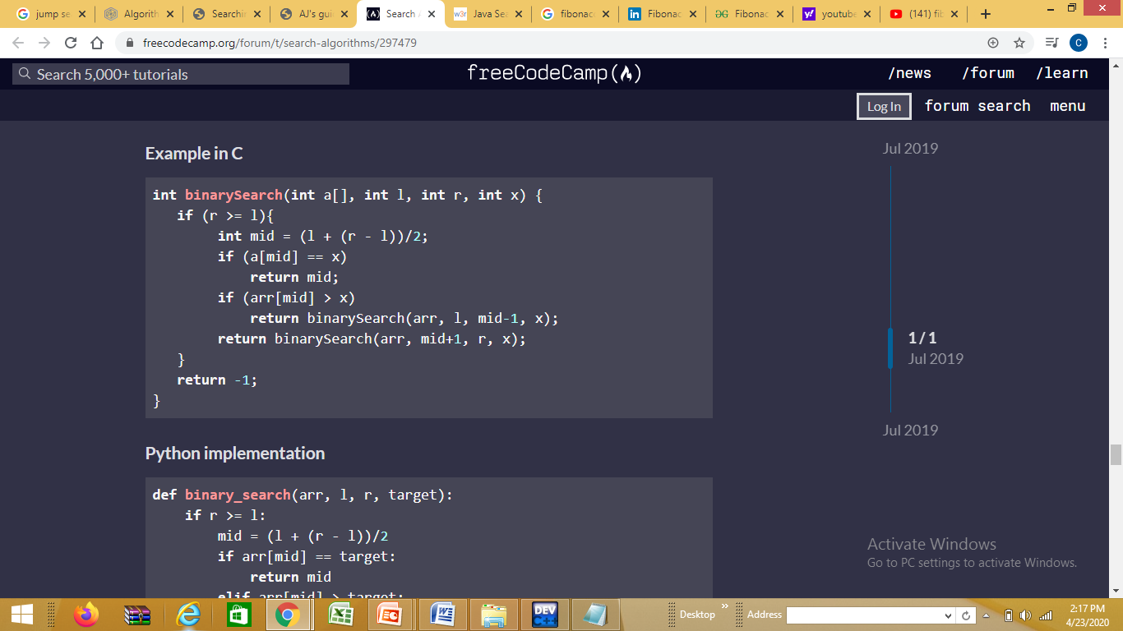
Linear Search Binary Search

Slide 15
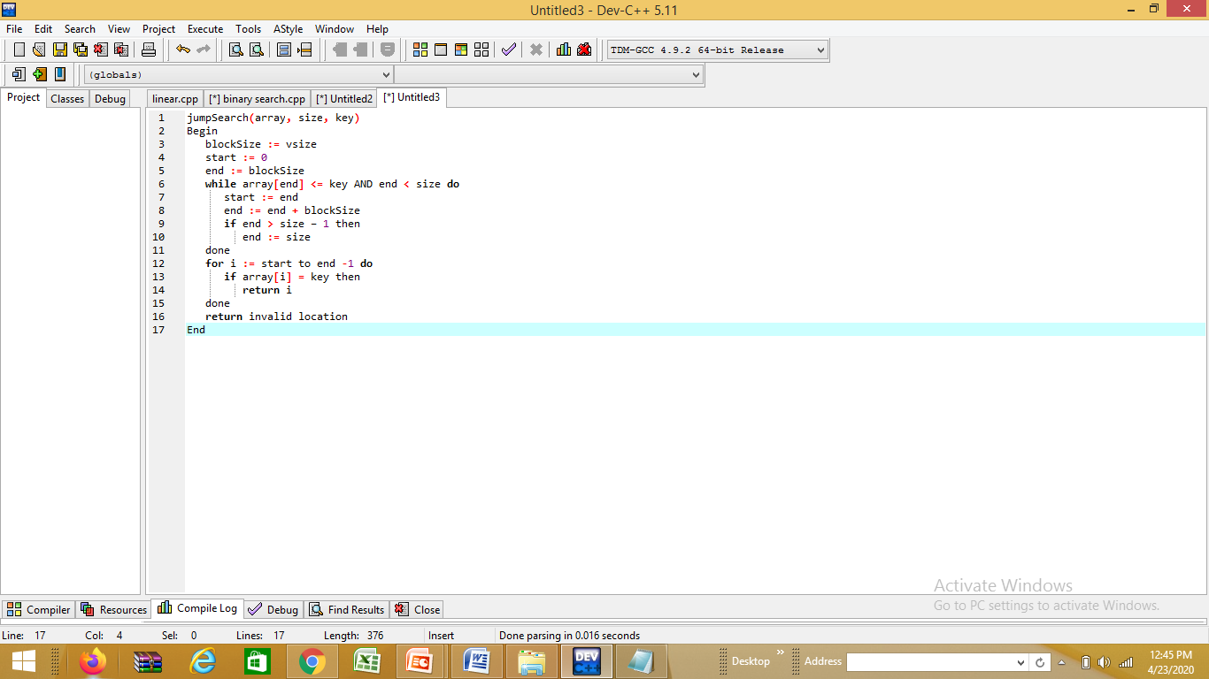
Jump Search
Jump Search is a searching algorithm for sorted arrays. It checks fewer elements (than linear search) by jumping ahead by fixed steps or skipping some elements in place of searching all elements.
For example:
suppose we have an array arr[] of size n
and block (to be jumped) size m.
Then we search at the indexes
arr[0], arr[m], arr[2m]…..arr[km] and so on.

Slide 16
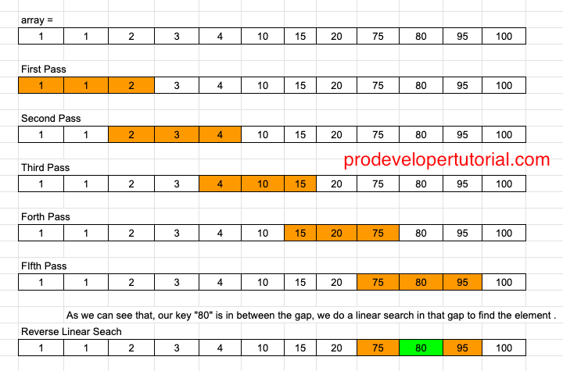
JUMP SEARCH EXAMPLE
1, 1, 2, 3, 4, 10, 15, 20, 75, 80, 92, 95, 100
Search element 80 where array size is 13 and bock size is 3
Key = 80
N = 13
Jump = SQRT(13) = 3

Slide 17
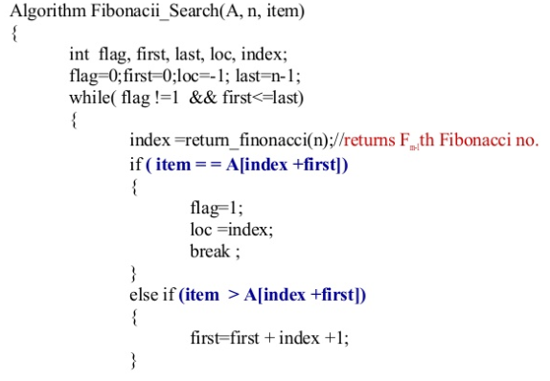

Fibonacci Search
Fibonacci Search Technique is a method of searching a sorted array using a divide and conquer algorithm that narrows down possible locations with the aid of Fibonacci numbers.
Fibonacci search examines locations whose addresses have lower dispersion,
Therefore it has an advantage over binary search in slightly reducing the average time needed to access a storage location.

Slide 18
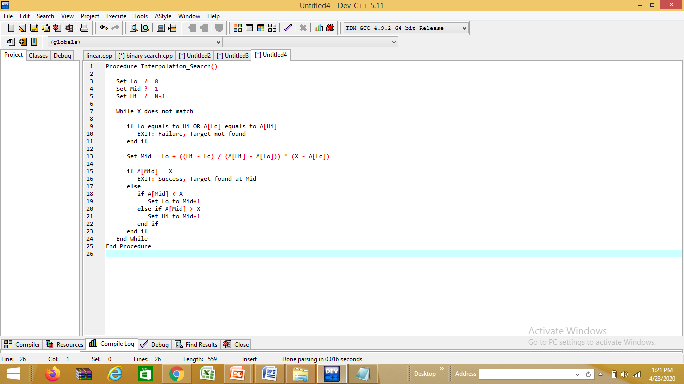
Interpolation Search
Interpolation search, also called as extrapolation search.
Interpolation searching algorithm is only used when the elements in an array is sorted and evenly distributed.
Interpolation search algorithm is the combination of both binary search algorithm and linear search algorithm.
Interpolation search parallels how humans search through a telephone book.

Slide 19
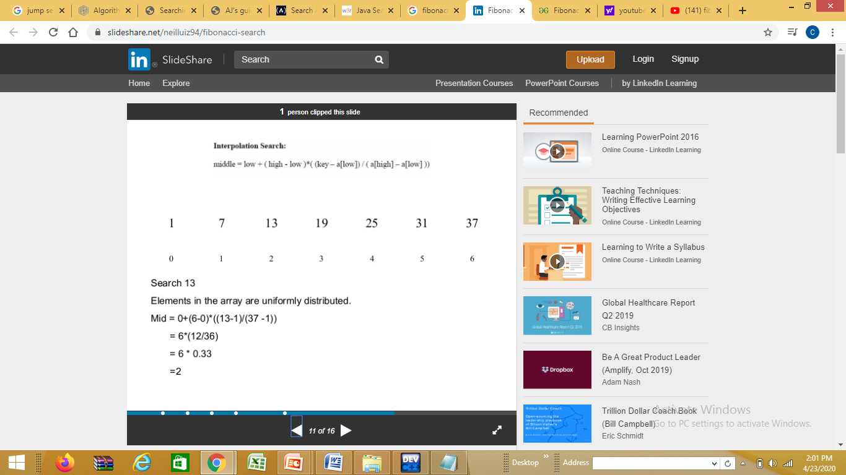
Interpolation Search Example
Array Contain 7 elements find the element 13 in the list
pos = low + ((key – arr[low]) * (high – low)) / (arr[high] – arr[low])

Slide 20
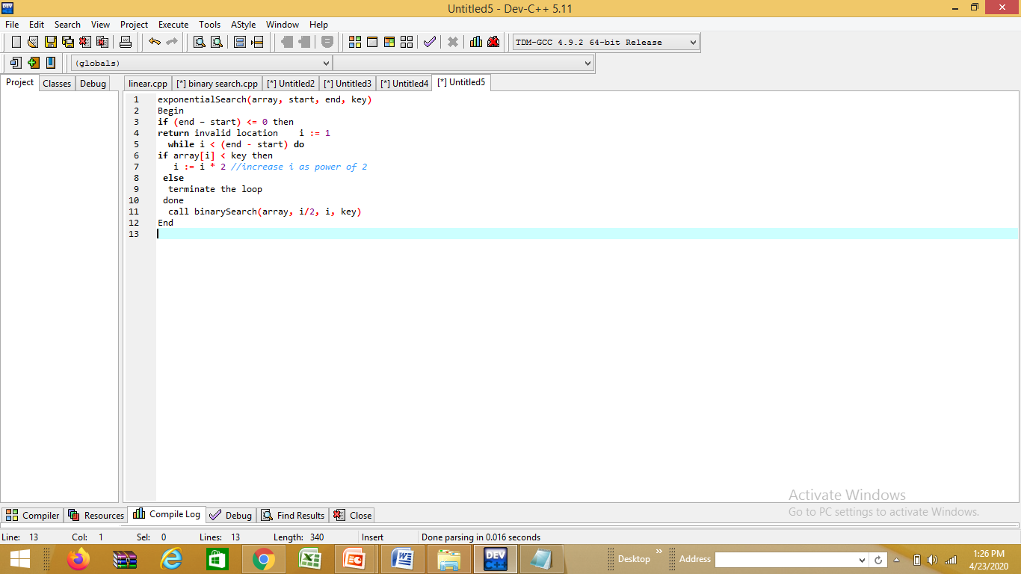
Exponential search
Exponential search is also known as doubling or galloping search.
This mechanism is used to find the range where the search key may present.
If L and U are the upper and lower bound of the list, then L and U both are the power of 2. For the last section, the U is the last position of the list. For that reason, it is known as exponential.

Slide 21
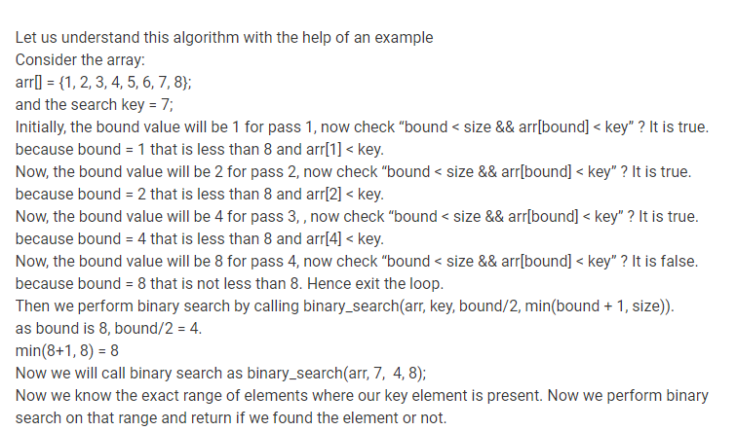
Exponential search example

Slide 22
COMPLEXITY OF SAERCHING TECHNIQUES
Technique | BEST CASE | AVERAGE CASE | WORST CASE
Linear Search | O(1) | O(N) | O(N)
Binary Search | O(1) | O(log n) | O(log n)
Jump Search | O(1) | O(√N) | O(√N)
Fibonacci Search | O(1) | O(log n) | O(log n)
Interpolation | O(log₂(log₂ n)) | O(log₂(log₂ n)) | O(n)
Exponential Search | O(1) | O(log₂ i) | O(log₂ i)
Note: We will discuss complexities in detail in day6

Slide 23
Problems to solve
1. Apply jump search to find data
A sorted list of data:
10 13 15 26 28 50 56 88 94 127 159 356 480 567 689 699 780 850 956 995
The search key 356
2. Apply Interpolation Search
Consider the array: arr[] = {1, 2, 3, 4, 5, 6, 7, 8};
and the search key = 7;
3. Apply Exponential Search to search element 45 in given sorted array
Input: arr[] = {10, 20, 40, 45, 55}
x = 45

Slide 24
Questions??
Q1. Jump search algorithm work in which condition?
Ans: when array should be sorted.
Q2. What will be the maximum number of comparisons that can be made in jump search algorithm (assuming k to be blocks jumped)?
Ans: k-1
Q3:What is the auxiliary space requirement of the jump search?
Ans: O(1)

Slide 25
Questions??
Q4:In which of the following case jump search will be preferred over binary search?
Ans:jumping backwards takes significantly more time than jumping forward
Q5: What is interpolation search in data structures?
Ans: Interpolation search is a modification of binary search, where additional information about the data is used to achieve better time complexity.
Q6:What is the advantage of an interpolation search?
Ans: data collection should be in a sorted form and equally distributed.

Slide 26
References
Data Structures and Algorithms Made Easy in Java: Data Structure and Algorithmic Puzzles” by Narasimha Karumanchi
Data Structures and Algorithms in Java” by Lafore
“Data Structures and Algorithms for GATE: Solutions to All Previous GATE Questions Since 1991” by Narasimha Karumanchi
https://www3.ntu.edu.sg/home/ehchua/programming/cpp/DataStructureAlgorithm.html
https://www.geeksforgeeks.org/data-structures/
https://www.prodevelopertutorial.com/searching-algorithm-3-jump-search-explanation-and-implementation-in-c-language/
https://www.prodevelopertutorial.com/ajs-guide-to-data-structures-and-algorithms-the-complete-guide-from-beginner-to-expert/

Slide 27
Fibonacci Search
Similarities with Binary Search
Works for sorted arrays
A Divide and Conquer Algorithm.
Has Log n time complexity.
Differences with Binary Search:
Fibonacci Search divides given array in unequal parts
Binary Search uses division operator to divide range. Fibonacci Search doesn’t use /, but uses + and -. The division operator may be costly on some CPUs.
Fibonacci Search examines relatively closer elements in subsequent steps. So when input array is big that cannot fit in CPU cache or even in RAM, Fibonacci Search can be useful.
Background: Fibonacci Numbers are recursively defined as F(n) = F(n-1) + F(n-2), F(0) = 0, F(1) = 1. First few Fibinacci Numbers are 0, 1, 1, 2, 3, 5, 8, 13, 21, 34, 55, 89, 144, …

Slide 28
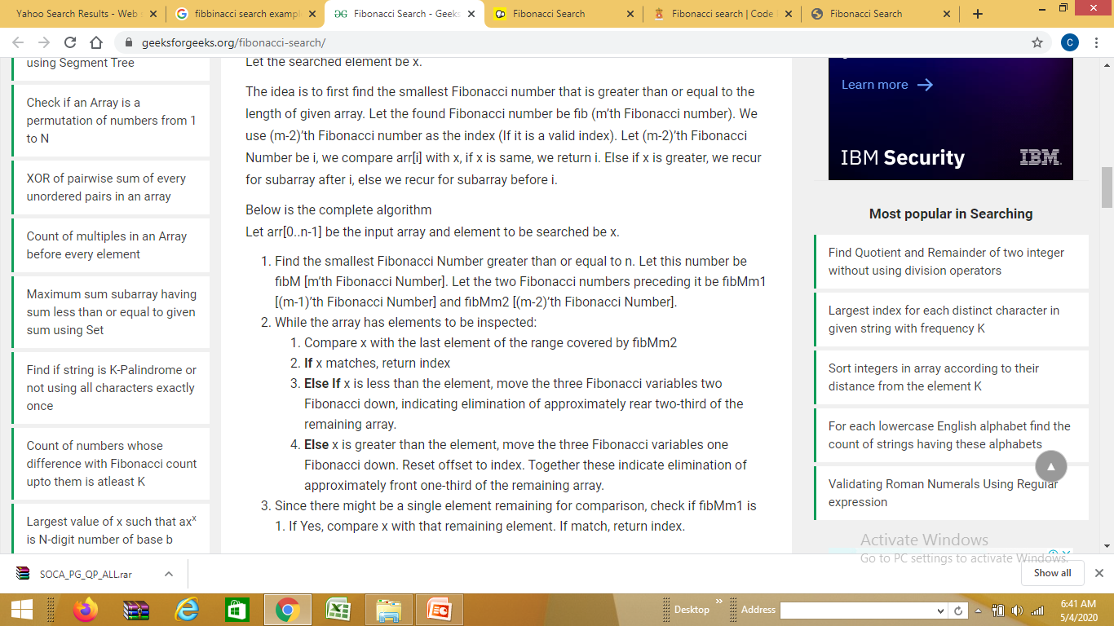
Algorithm: Let the searched element be x.

